Slide 1

PBG New Product Process
July 2019
Notes:
Welcome all

Slide 2
A New Item is defined as …???

Slide 3
Notes:
Important to stress that new product submissions need to be early enough to allow the student testing to be completed and submitted prior to the deadline dates.

Slide 4
New online Product Request form Submitted via PBG website
Members attend meeting to sample new items to determine usage
Specs for items with usage indicated by members are prepared
Products added to customer master and available to order
E-mail sent to member to agree to test the product
PBG Executive Committee review requests for like items
US Foods processes pricing solicitations
US Foods Contracts with Awarded Vendor
Member responds to product test e-mail
Member conducts testing and submits results
Vendor responds to US Foods pricing solicitations
Recommendations for award reviewed and awarded by Executive Board
Vendor provides samples to member
E-mail sent to member requesting test results
Pricing and product submissions reviewed by US Foods and Exec Dir.
Notes:
Explain this is the flow chart of the timeline.

Slide 5
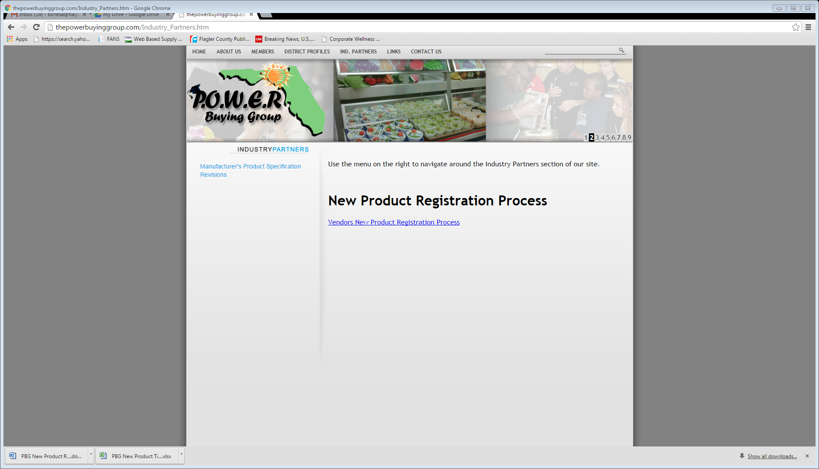
New Online Product Request Form Submitted
Search: POWER Buying Group
www.thepowerbuyinggroup.com
Open: IND. PARTNER tab
Notes:
How to access the new product form

Slide 6
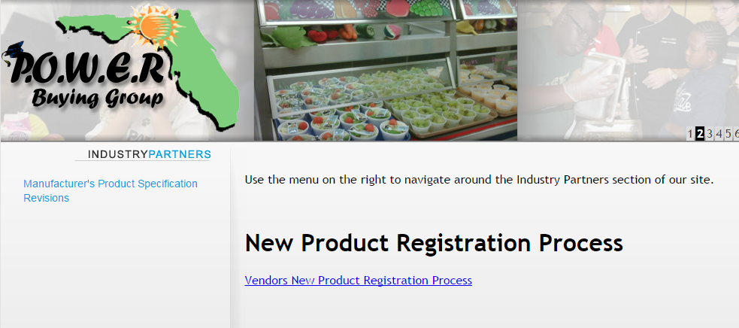
New Online Product Request Form Submitted
Click on link to view instructions
Notes:
Access the instructions

Slide 7

New Online Product Request Form Submitted
The FIRST step in the instructions includes the LINK to the form
Notes:
The form is accessed through the link on the first instruction

Slide 8
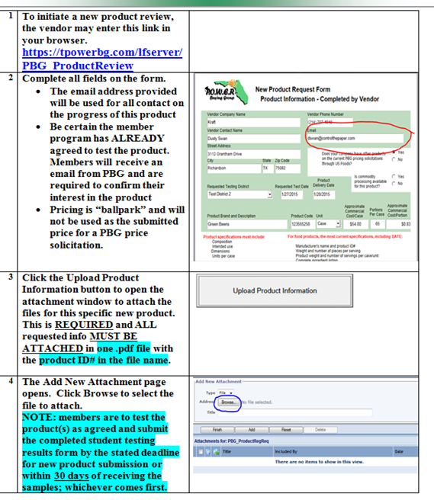
New Online Product Request Form Submitted
Click on the link to access the form.
Suggestion: read all instructions prior to submitting the form to ensure all required information is included.
Notes:
Read all instructions prior to submitting the form

Slide 9
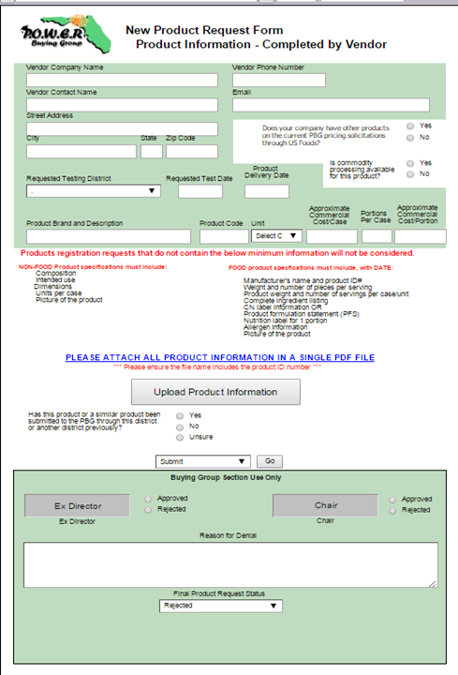
New Online Product Request Form Submitted
Complete all fields.
Notes:
same as many online applications, form will not submit if not complete

Slide 10
New Online Product Request Form Submitted
Product registration requests that do not contain the below minimum information will not be rejected.
NON-FOOD Product specifications must include:
Composition
Intended Use
Dimensions
Units Per Case
Picture of Product
FOOD Product specifications must include, with DATE:
Manufacturer’s name and product ID #
Weight and number of pieces per serving
Product weight and number of servings per case/unit
Complete ingredient listing
CN label information OR
Product formulation statement (PFS)
Nutrition label for 1 portion
Allergen information
Picture of product
ATTACH ALL PRODUCT INFORMATION IN A SINGLE PDF FILE - THE FILE NAME MUST INCLUDE THE PRODUCT ID# AND PRODUCT NAME
Ensure all required information is included in the attached file.
The ONE file must include the Product ID# and name in the .pdf file name.
Notes:
Ensure all required items are included in specification file

Slide 11
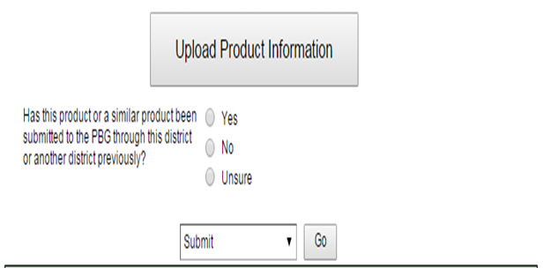
New Online Product Request Form Submitted
Click the Upload Product Information button to upload the one product specification file.
This complete process is required for each individual product to be student tested.
DO NOT UP LOAD MULTIPLE PRODUCTS IN THE SAME REQUEST
Notes:
Upload ONE file per product

Slide 12
Each submission is automatically emailed to the Executive Director and the New Product Chair to determine if the submission is complete.
New Online Product Request Form Submitted
Notification
 | Process Notification - Assignment Please review the PBG_ProductRegReq originally from Dusty Swan on Dec 7, 2015 12:33 PM. You may access the document directly by clicking on this document link. PBG_ProductRegReq Click the Inbox link to see all of your assigned documents. Inbox
Notes:
Notification regarding complete or incomplete submission.

Slide 13
Vendors receive an email confirming submission is or is not complete.
Incomplete submissions may be resubmitted.
New Online Product Request Form Submitted
Notes:
Notification regarding complete or incomplete submission.

Slide 14
E-mail Sent To Member To Agree To Test The Product
Member selected on form receives an email requesting confirmation they agree to test the product.
Notes:
Member must agree to test the product

Slide 15
Member Responds To Product Test E-mail
Members are required to respond to the email with either a “YES” or a “NO” answer (within 3 business days is preferred).

Slide 16
Vendor receives an email confirming member agrees to test the product
Vendor Provides Samples To Member
Notes:
Vendor then contact member

Slide 17
Vendor Provides Samples To Member
The vendor will contact the member to arrange for product delivery location and testing.
PBG requires members receive at least one production case for student testing.
Notes:
Vendor and member agree on delivery location and planned testing date

Slide 18
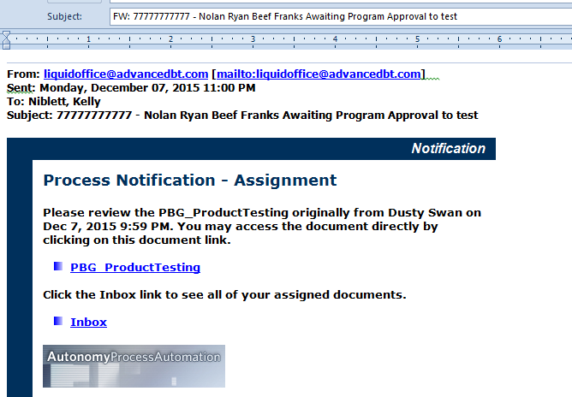
E-mail Sent To Member Requesting Test Results
Member receives email with link to the form to submit the student test results.
Notes:
Member receives email to test product

Slide 19
Member Conducts Testing And Submits Results
Members are to test the product within 30 days or prior to the new item deadline.
Products not tested before the deadline remain active and will be reviewed during the next new item period

Slide 20
Member Conducts Testing And Submits Results
Member enters student test results and comments are required on all student testing forms.
Notes:
Additional commments are encouraged

Slide 21
E-mail Sent To Member Requesting Test Results
The Executive Director and New Product Chair confirm if food product test results are at least 70% for committee consideration.
Notes:
Unacceptable student testing results are viewed by the committee

Slide 22
E-mail Sent To Member Requesting Test Results
Vendor receives email with student test results.
Notes:
Results are automatically copied from the submission form

Slide 23
PBG Committees Review Requests
The Executive Committee review all vendor submissions, taking into consideration:
  Student testing results.
  Completeness of submission (all required information from vendor and member is included).
  The uniqueness of the product.
  Smart Snack compliance.
Items are reviewed on an individual basis.
Notes:
Documentation of the process and review for each product is maintained by the Executive Director

Slide 24
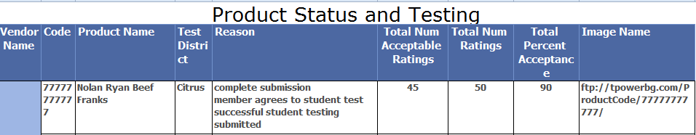
PBG Committees Review Requests
Spreadsheet auto-populated with most current information for each product
Notes:
Members can view product testing status using link on the members-only web page

Slide 25
Members attend meeting to sample new items to determine usage
Vendors are requested to bring samples of new items to a PBG meeting for member district representatives to taste and evaluate for use in their districts.
Members will share projected usage with Executive Director.

Slide 26
Specifications For Approved Products Are Prepared
The Executive Director prepares specifications for each product for the price solicitation by US Foods for new items determined to have projected usage.
US Foods requests an addition to the contract for products determined to be “additional flavors” of currently awarded items.
Criteria are:
  flavor different from awarded product(s)
  SAME nutrition and meal component crediting as awarded product
  SAME portion price as awarded product
Notes:
The products approved by the membership are moved forward for pricing

Slide 27
US Foods Processes Pricing Solicitations
US Foods distributes the price solicitation to all interested vendors.
Vendors are to contact US Foods to be included on the price solicitation distribution.
Dan.cooper@usfoods.com
Craig.keppen@usfoods.com
Notes:
Contact US Foods has details on this process

Slide 28
Vendor Responds to US Foods Pricing Solicitations
Vendors must respond with all requested pricing and documentation including complete specifications and the Buy American form by solicitation deadline.
Notes:
Vendors are encouraged to read attached instructions carefully

Slide 29
Pricing And Product Submissions Reviewed By US Foods And PBG Exec Dir.
Each product is reviewed to determine the lowest-price, responsive item meeting the specification criteria.
Notes:
Vendor submission must be complete with ALL required information to be considered

Slide 30
Recommendations For Award Are Reviewed And Awarded By Executive Committee
Recommendations for award are presented to the PBG Executive Committee which votes for final approval of all products reviewed.
Notes:
Awarded as line items or categories as that is stated in the solicitation product specifications

Slide 31
US Foods Contracts with Awarded Vendor
US Foods contacts all awarded companies and works with vendors to finalize contract details.

Slide 32
Products Added To Customer Master And Available To Order
An updated Customer Master is then emailed to all members and published on the PBG website.
http://thepowerbuyinggroup.com/
Notes:
PBG Customer Master includes all pertinent product information

Slide 33
Products Added To Customer Master And Available To Order
Members then notify their US Foods reps of the specific products and their planned usage for the newly awarded items, adding products to their Order Guide.
US Foods orders products to be available for delivery to the members.
Notes:
Updating the Order Guide and providing planned usage info is an important step in the process

Slide 34
Questions?
For follow-up contact the PBG Executive Director, at powerbuyinggroup@gmail.com
Notes:
PBG will take all recommendations under advisement and will provide feedback after the discussion with the Executive Committee

Slide 35
Thank you!
Notes:
THANKS to all

